Slide 1
SAGE Research Proposal
Spring 2021
Lalitha Madduri, B.S. CS ‘21
Jeff Bender, Gail Kaiser

Slide 2
Main Objectives
Ramp up / Environment setup
Processing fs2 data
Puzzle Authoring
Instruction clarification
Modifying surveys for fs3

Slide 3
Authoring Puzzles
Prior experience: Parsons puzzles
Goals:
Motivating scenarios
Memorable segments
Challenging, but not tricky
Positive impression
Notes:
worked on making parsons puzzles: incorrect ordering, fill in the missing block, find the type of conditional to use

Slide 4
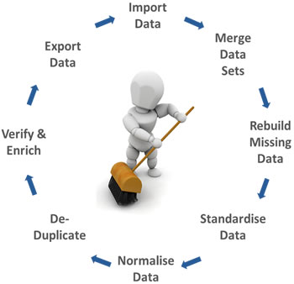
Processing Fs2 Data
Notes:
qualtrics survey, in excel scripts python scripts for cleanup
to csv
matplotlib for charts

Slide 5
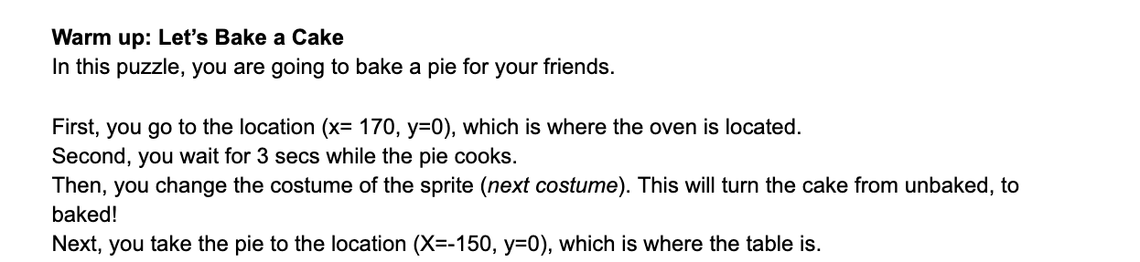
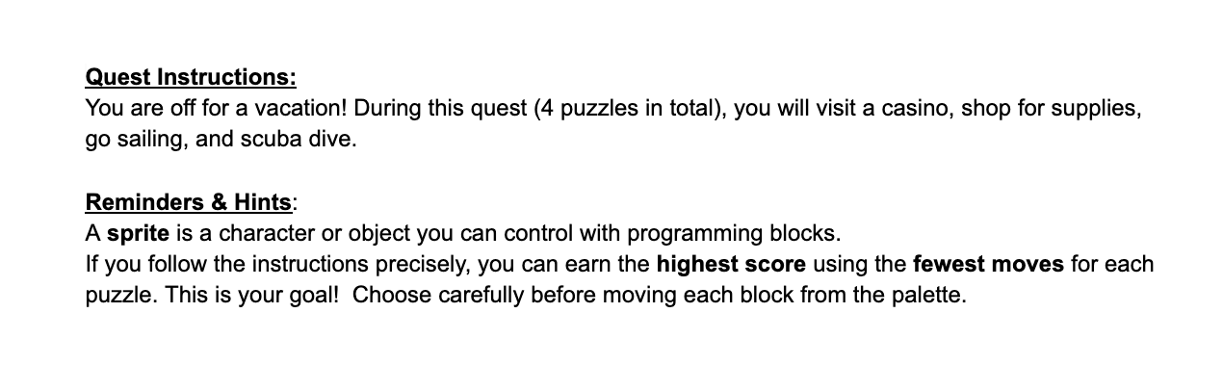
Instruction clarification
Conditionals
Less words
More action
Sequences
Notes:
IM survey showed the students felt a lot of pressure on them and an expectation to do well
-more guiding instructions
-tutorial makeover for FS3

Slide 6
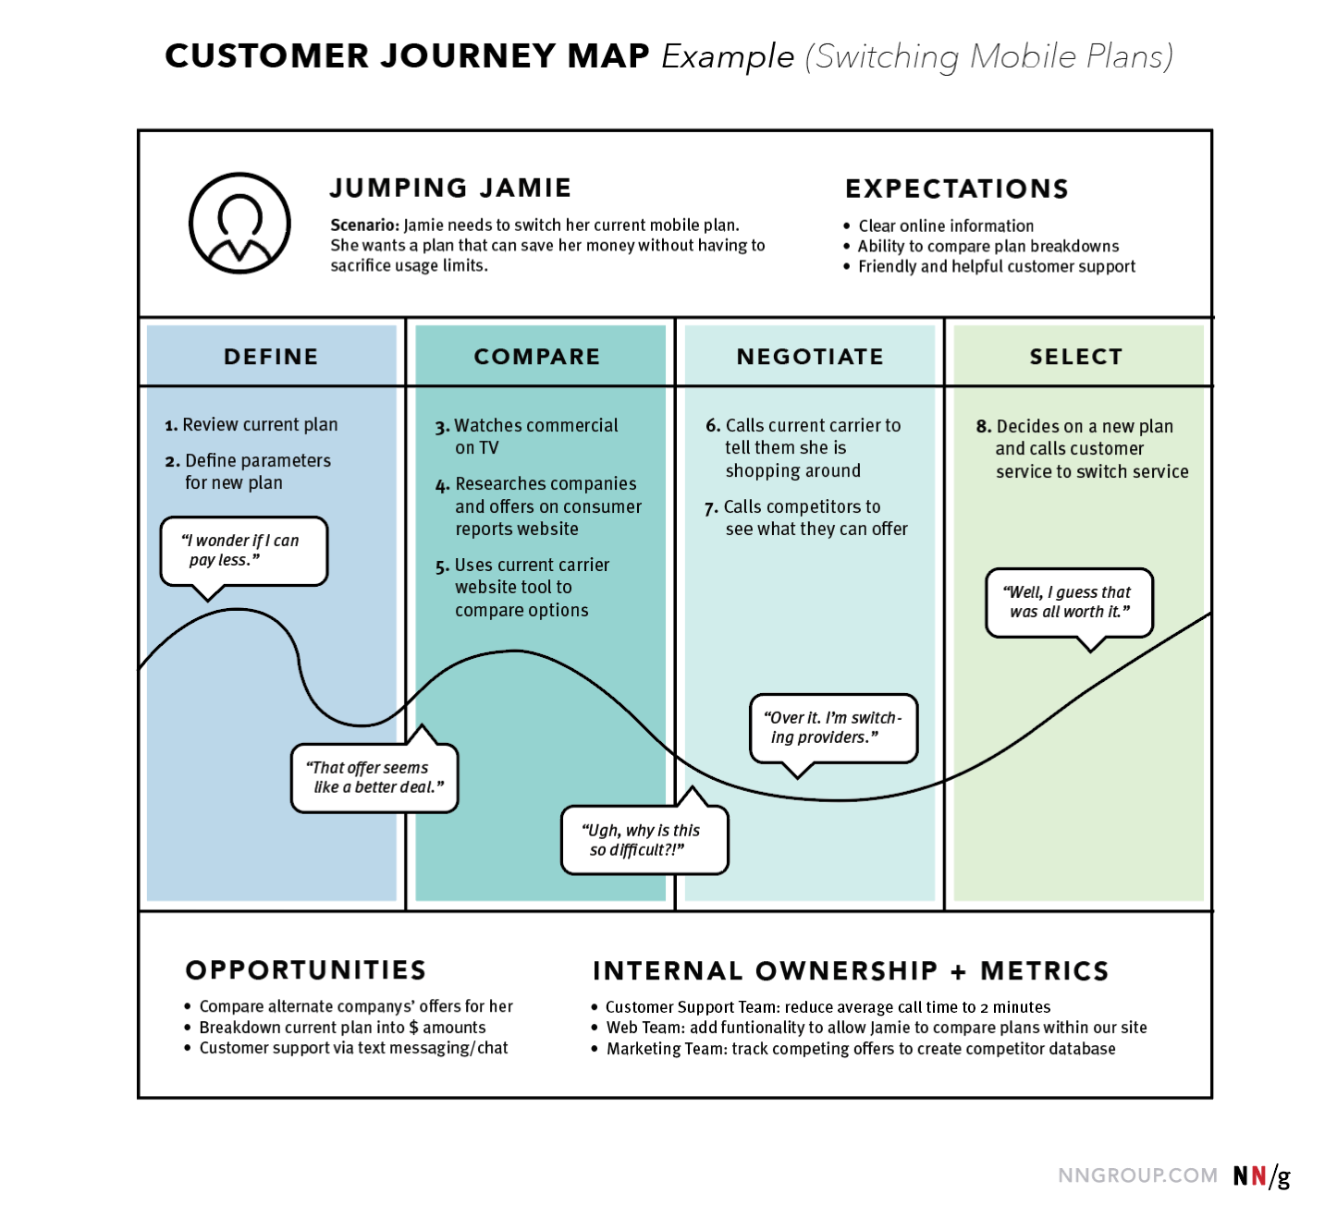
For FS3
Creating protocol content for looping
Finalize condition set & demographic constraints
Instructor review
Improve IM (Intrinsic Motivation) survey
HCD sessions + setup
User journey maps: instructor + student

Slide 7
Timeline
Sprint 1 | Ramp up, environment setup, Instruction cleanup, processing fs2 data (qualtrics)
Sprint 2 | Puzzle authoring, creating protocol content for looping, finalize condition set
Sprint 3 | Instructor review, journey maps, iteration based on feedback
Sprint 4 | Improve IM survey, Assist with paper

